Slide 1

IT Application Security - Unit III
- Dr. Gopal Rawat

Slide 2
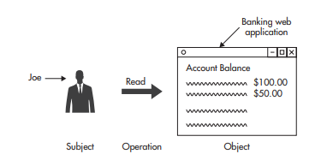
Authentication
Access control mechanism:
- authentication
- authorization

Slide 3
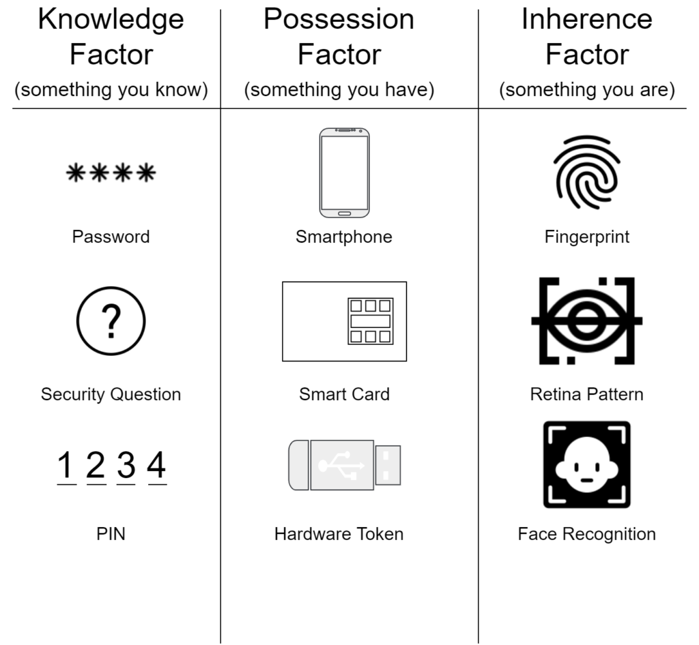
Authentication: Fundamentals
Proving Your Identity
Something you know
Something you are
Something you have
Validating Credentials
Two-Factor
Three-Factor Authentication

Slide 4
Authentication: Fundamentals
Web Application Authentication
Password-Based Authentication Systems
Insecure Transmission
Repeated Exposure
Insecure Storage
Single Sign-on Authentication
Google account

Slide 5
Authentication
Top threats that exploit authentication vulnerabilities include:
Network eavesdropping
Brute force attacks
Dictionary attacks
Cookie replay attacks
Credential theft

Slide 6
Network Eavesdropping
If authentication credentials are passed in plaintext from client to server
an attacker uses network monitoring software on a host on the same network
captures traffic (usernames and passwords)
Countermeasures
Make sure passwords are encrypted
encrypted communication channel (SSL)
Use authentication mechanisms that do not transmit the password over the network such as Kerberos protocol or Windows authentication

Slide 7
Brute Force Attacks
Brute force attacks rely on computational power to crack hashed passwords or other secrets secured with hashing and encryption
To mitigate the risk, use strong passwords

Slide 8
Dictionary Attacks
This attack is used to obtain password
Most password systems do not store plaintext passwords or encrypted passwords
Compromised key leads to the compromise of all passwords
Lost keys mean that all passwords are invalidated

Slide 9

Importance of Password Complexity
Best Practices:
Require Minimum Password Length
Enforce Minimum Password Complexity
Rotate Passwords
Require Password Uniqueness
Password Cannot Equal Username
Allow Accounts to Be Disabled
Properly Store Passwords

Slide 10
Cookie Replay Attacks
the attacker captures the user’s authentication cookie using monitoring software
replays it to the application to gain access under a false identity
Countermeasures
Use an encrypted communication channel provided by SSL
Use a cookie timeout to a value that forces authentication after a relatively short time interval
Use a nonce value

Slide 11
Credential Theft
Countermeasures
Use and enforce strong passwords
Store password verifiers in the form of one way hashes with added salt
Enforce account lockout for end-user accounts after a set number of retry attempts
Allow the user to choose to not save credentials (default policy)

Slide 12
Securing Authentication
Secure the Transmission
Allow Account Lockout
Allow Accounts to Be Disabled
No Default Accounts
Don’t Hard-Code Credentials
Avoid Remember Me (Stay Signed In)

Slide 13
Single Sign On (SSO)
How single sign-on works (fusionauth.io)
OIDC (OpenID Connect)
SAML (Security Assertion Markup Language)
Notes:
SAML uses signed and/or encrypted XML documents to convey information about users. Both SAML and OIDC are browser based. They require functionality such as HTTP redirects, cookies and the ability to interact using URLs

Slide 14
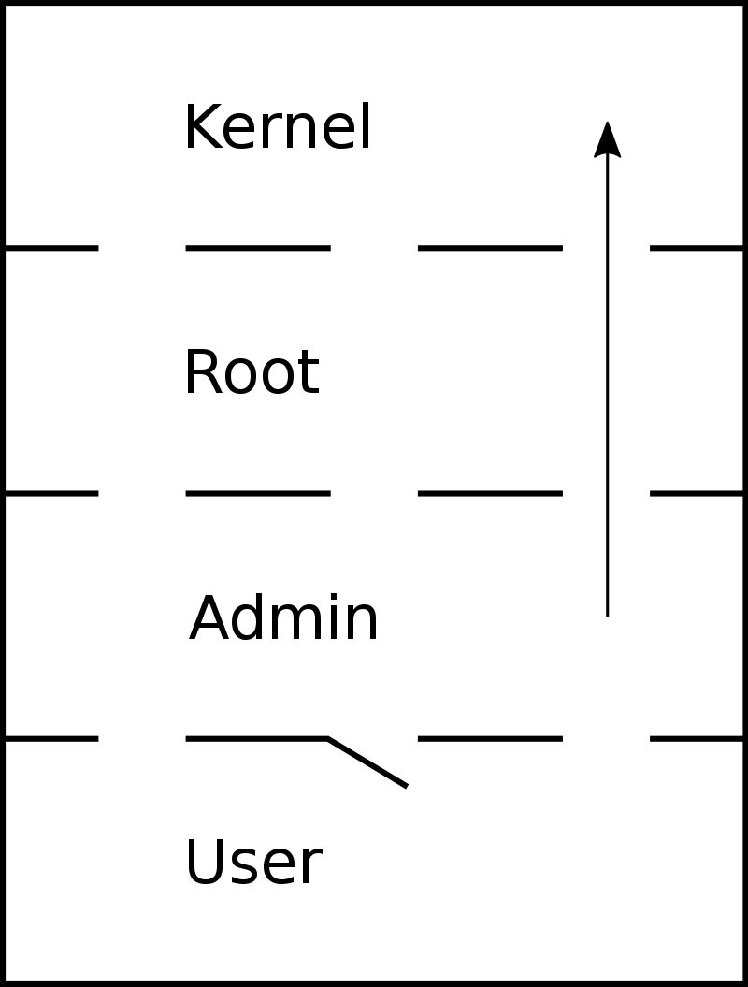
Authorization
the process of determining whether a subject has sufficient permission to perform a given operation against a target object (resource)
Top threats that exploit authorization vulnerabilities:
Elevation of privilege
Disclosure of confidential data
Data tampering
Luring attacks
Vertical
Horizontal

Slide 15
Luring Attack
A luring attack occurs when an entity with few privileges is able to have an entity with more privileges perform an action on its behalf
Countermeasure
restrict access to trusted code with the appropriate authorization

Slide 16
Access Control Model
Discretionary Access Control (DAC)
- access control is left to the discretion of the owner of an object or other resource
Mandatory Access Control (MAC)
-access control is determined by the system, or by system administrators
Role-Based Access Control (RBAC)
-nondiscretionary model, like MAC, but which implements access control by means of roles
Hybrid systems

Slide 17
Types of Permissions
Read access
- ability to see what something is, to have its contents presented
Write access
- ability to change something
Execute access
-ability to run a piece of code in order to do something

Slide 18
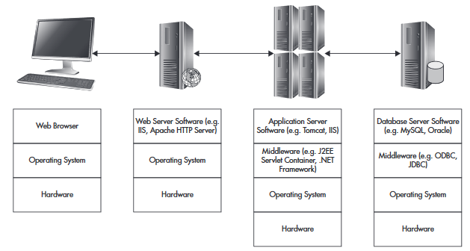
AUTHz or A2 Checkpoints
Notes:
Microsoft’s Internet Information
Server (IIS) or the open-source Apache server

Slide 19
Securing Web Application Authorization
Controls by Layer:
Web Server Layer
IP address blacklisting or whitelisting
URL authorization
Operating System authorization
Application Server Layer
Application Compartmentalization
Servlet and app Server restrictions
Code access Security

Slide 20
Authorization Best Practices
Failing Closed
Operating with Least Privilege
Separating Duties
Defining Strong Policies
Keeping Accounts Unique
Authorizing on Every Request
Using Server-Side Authorization
Mistrusting Everybody

Slide 21

Attacks against Authorization
Forceful browsing (URLs such as “main.html” or “admin.php” are both easily guessable ,surprisingly common)
Input Authorization/Parameter Tampering (any data stored in URL parameters, cookies, or form fields is subject to tampering)
HTTP Header Manipulation
Cross-Site Request Forgery (CSRF)

Slide 22
OAuth (Open Authentication Framework)
Guide on OAuth2.0 OAuth.com - OAuth 2.0 Simplified
An Illustrated Guide to OAuth and OpenID Connect – YouTube
OAuth2.0 Resource
OAuth Playground (Try) OAuth 2.0 Playground
Workshop: GitHub - andifalk/secure-oauth2-oidc-workshop: Hands-On Workshop for OAuth 2.0 and OpenID Connect 1.0

